Slide 1

UNIVERSITY INSTITUTE OF ENGG.
UIE ACADEMIC UNIT-2
Bachelor of Engineering (Computer Science & Engineering)
Digital Electronics Lab
20ECP156
Prepared By:- Rachit Manchanda
&
Sanjima Rana
DISCOVER . LEARN . EMPOWER

Slide 2
EXPERIMENT
Design a stress measuring game using decade counter (CD4017).

Slide 3
Experiment-9 Design a LED Chaser Circuit using Johnson Decade Counter (CD 4017) and Push button.
Outcomes
At the end of this experiment, student will be able learn about Johnson Decade Counter and they will be able to extract relevant information from Counter Data sheet.
Also, student will learn how counter works and by how pressing the push button the sequence of LED’S changes.

Slide 4
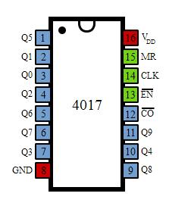
LED Chaser (IC 4017)
The so-called chaser or sequencer is one of the most popular types of LED-driving circuit and is widely used in advertising displays and in running-light ‘rope’ displays in small discos, etc.
It consists — in essence — of a clocked IC or other electronic unit that drives an array of LEDs in such a way that individual LEDs (or small groups of LEDs) turn on and off in a predetermined and repeating sequence.

Slide 5
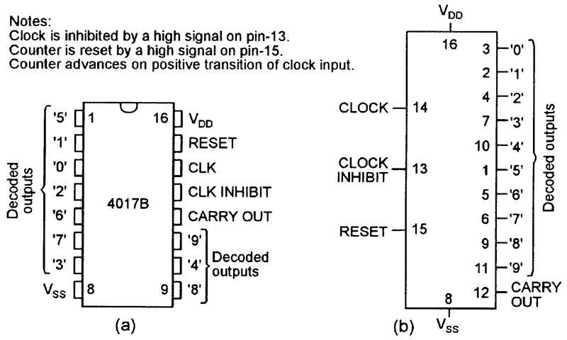
4017B Pin-out

Slide 6
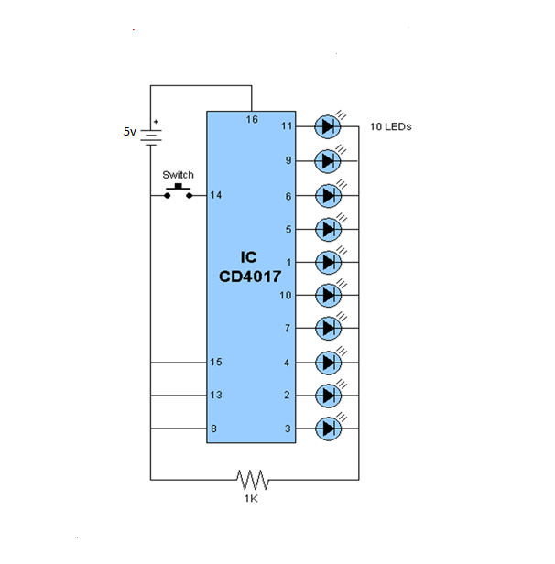
LED Chaser Circuit using Johnson Decade Counter and Push button

Slide 7
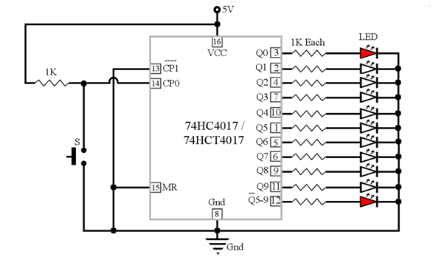
Schematic Diagram showing the functioning of LED chaser

Slide 8
Tasks
TinkerCAD Simulation
IC identification and circuit diagram
Hardware connections on breadboard

Slide 9
EVALUATION FOCUS
20
Correctness of the circuit connections
Ability to read and extract the required information from data sheet in order to design a circuit.
Validated output from the circuit.
Documentation of the work done
5
5
5
5

Slide 10
Cheat sheet for Viva-Voce!!!
Questions related to connections in the bread board.
Questions related to the choice of voltage and resistance used in the circuit.
Questions related to information extracted from data sheet.
Questions related to counters, its types and its applications.
Questions related to data acquisition.

Slide 11
What you have achieved today!!!
Course Objective
To conceive, analyse, design and build combinational and sequential digital logic solutions for everyday problems.
Course Outcomes
At the end of the course, a student will be able to:
identify relevant information to supplement the digital system design.
analyze the elements of digital system abstractions such as digital representations of information, digital logic and Boolean algebra.
design digital systems based on concepts that enable autonomous behaviour.
prepare professional quality textual and graphical presentations.
work in a team that can propose, design, implement and report on digital systems’ project.

Slide 12
References
https://www.electroschematics.com/wp-content/uploads/2011/04/4017-ic-datasheet.pdf
https://www.ti.com/lit/ds/schs027c/schs027c.pdf?ts=1597310656008&ref_url=https%253A%252F%252Fwww.google.com%252F
https://www.nutsvolts.com/magazine/article/led-chaser-sequencer-circuits
https://electrosome.com/led-chaser-ic-4017-ic-555/

Slide 13
THANK YOU
For queries
Email: rachit.ece @cumail.in

